Slide 1
Git
Internship 2016

Slide 2
Agenda
A brief History of Git
Version control system
Why Git ?
Download and install Git
Introduce yourself to Git
Create and fill a repository
Clone a repository from elsewhere
The repository
Getting started (git init & git repository)
Making commits
Commit messages
Typical workflow
Examples

Slide 3
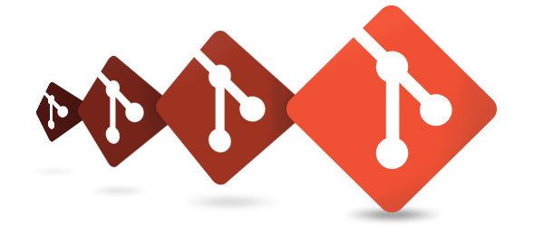
A brief History of Git
Linux uses BitKeeper to manage Linux code
Ran into BitKeeper licensing issue
Liked functionality
Looked at CVS as how not to do things
April 5, 2005 - Linux sends out email showing first version
June 15, 2005 - Git used for Linux version control

Slide 4
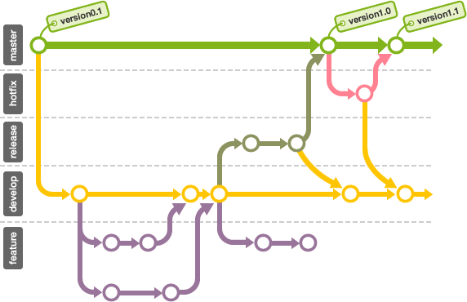
Version control systems
Version control (or revision control, or source control) is all about managing multiple versions of documents, programs, web sites, etc.
Almost all “real” projects use some kind of version control
Essential for team projects, but also very useful for individual projects
Some well-known version control systems are CVS, Subversion, Mercurial, and Git
CVS and Subversion use a “central” repository; users “check out” files, work on them, and “check them in”
Mercurial and Git treat all repositories as equal
Distributed systems like Mercurial and Git are newer and are gradually replacing centralized systems like CVS and Subversion

Slide 5

Why Git ?
Git has many advantages over earlier systems such as CVS and Subversion
More efficient, better workflow, etc.
See the literature for an extensive list of reasons
Of course, there are always those who disagree
Has a local copy
For working by yourself:
Gives you a “time machine” for going back to earlier versions
Gives you great support for different versions (standalone, web app, etc.) of the same basic project
For working with others:
Greatly simplifies concurrent work, merging changes
For getting an internship or job:
Any company with a clue uses some kind of version control
Companies without a clue are bad places to work

Slide 6
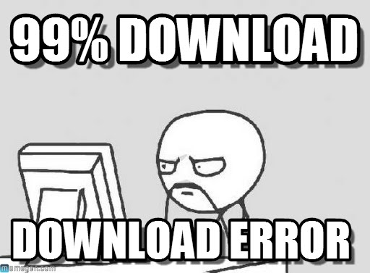
Download and install Git
Here’s the standard one: http://git-scm.com/downloads
Here’s one from StackExchange: http://stackoverflow.com/questions/315911/git-for-beginners-the-definitive-practical-guide#323764

Slide 7

Introduce yourself to Git
Enter these lines (with appropriate changes):
git config --global user.name "John Smith"
git config --global user.email jsmith@endava.com
You only need to do this once
If you want to use a different name/email address for a particular project, you can change it for just that project
cd to the project directory
Use the above commands, but leave out the --global

Slide 8

Create and fill a repository
1. cd to the project directory you want to use
2. Type in git init
This creates the repository (a directory named .git)
You seldom (if ever) need to look inside this directory
3. Type in git add .
The period at the end is part of this command!
Period means “this directory”
This adds all your current files to the repository
4. Type in git commit –m "Initial commit"
You can use a different commit message, if you like

Slide 9

Clone a repository from elsewhere
git clone URL
git clone URL mypath
These make an exact copy of the repository at the given URL
git clone git://github.com/rest_of_path/file.git
Github is the most popular (free) public repository
All repositories are equal
But you can treat some particular repository (such as one on Github) as the “master” directory
Typically, each team member works in his/her own repository, and “merges” with other repositories as appropriate

Slide 10
The repository
Your top-level working directory contains everything about your project
The working directory probably contains many subdirectories—source code, binaries, documentation, data files, etc.
One of these subdirectories, named .git, is your repository
At any time, you can take a “snapshot” of everything (or selected things) in your project directory, and put it in your repository
This “snapshot” is called a commit object
The commit object contains (1) a set of files, (2) references to the “parents” of the commit object, and (3) a unique “SHA1” name
Commit objects do not require huge amounts of memory
You can work as much as you like in your working directory, but the repository isn’t updated until you commit something

Slide 11
init and the .git repository
When you said git init in your project directory, or when you cloned an existing project, you created a repository
The repository is a subdirectory named .git containing various files
The dot indicates a “hidden” directory
You do not work directly with the contents of that directory; various git commands do that for you
You do need a basic understanding of what is in the repository

Slide 12
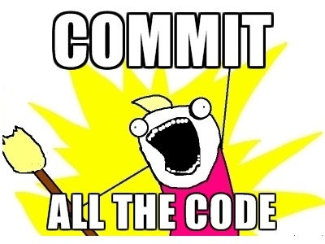
Making commits
You do your work in your project directory, as usual
If you create new files and/or folders, they are not tracked by Git unless you ask it to do so
git add newFile1 newFolder1 newFolder2 newFile2
Committing makes a “snapshot” of everything being tracked into your repository
A message telling what you have done is required
git commit –m “Uncrevulated the conundrum bar”
git commit
This version opens an editor for you the enter the message
To finish, save and quit the editor
Format of the commit message
One line containing the complete summary
If more than one line, the second line must be blank

Slide 13

Commit messages
In git, “Commits are cheap.” Do them often.
When you commit, you must provide a one-line message stating what you have done
Terrible message: “Fixed a bunch of things”
Better message: “Corrected the calculation of median scores”
Commit messages can be very helpful, to yourself as well as to your team members
You can’t say much in one line, so commit often

Slide 14
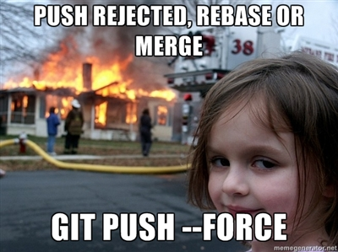
Typical workflow
git pull /remote_repository/
Get changes from a remote repository and merge them into your own repository
git status
See what Git thinks is going on
Use this frequently!
Work on your files (remember to add any new ones)
git commit –m “What I did”
git push

Slide 15


Slide 16



Alexandr Bolbocean
Ariel Chelsau
alexandr.bolbocean@endava.com
en_abolbocean
ariel.chelsau@endava.com
en_achelsau
Alexandra Paicu
alexandra.paicu@endava.com
en_apaicu

